Slide 1

Life solution enterprises
Objective:- A start-up to Optimize the potential source of business coordination to Explore Collectively.
Vision :- To be the choice of trust for All Business Partner for Development.
Mission:- Collectively Diversified Potential Utilization of different sources .

Slide 2
About life solution
A registered company for different kind of new potential startup for optimizing their Skill to the direction of getting - Name & Fame.
Consultancy for the owning of their potential business.
Get connect to develop Idea & Business for better Growth.
Sabka Sath ,Sabka Vishwas and Sabka Vikas.. Is the Mantra of the Life Solution Enterprises……

Slide 3
Life solution scope of work
Hospitality: - Planning-New Outlet, Different Setup & Development.
Commercial Kitchen Equipment’s:- Fabrication, Domestic, Imported, Repairing & Maintenance (AMC/CAMC).
Policy:-Cashless Medical & Investments Planning.
Consultancy: - Facilitate Manpower & Property.
Travel & Tour Operator.
International Patient Business.
Manpower consultant.

Slide 4
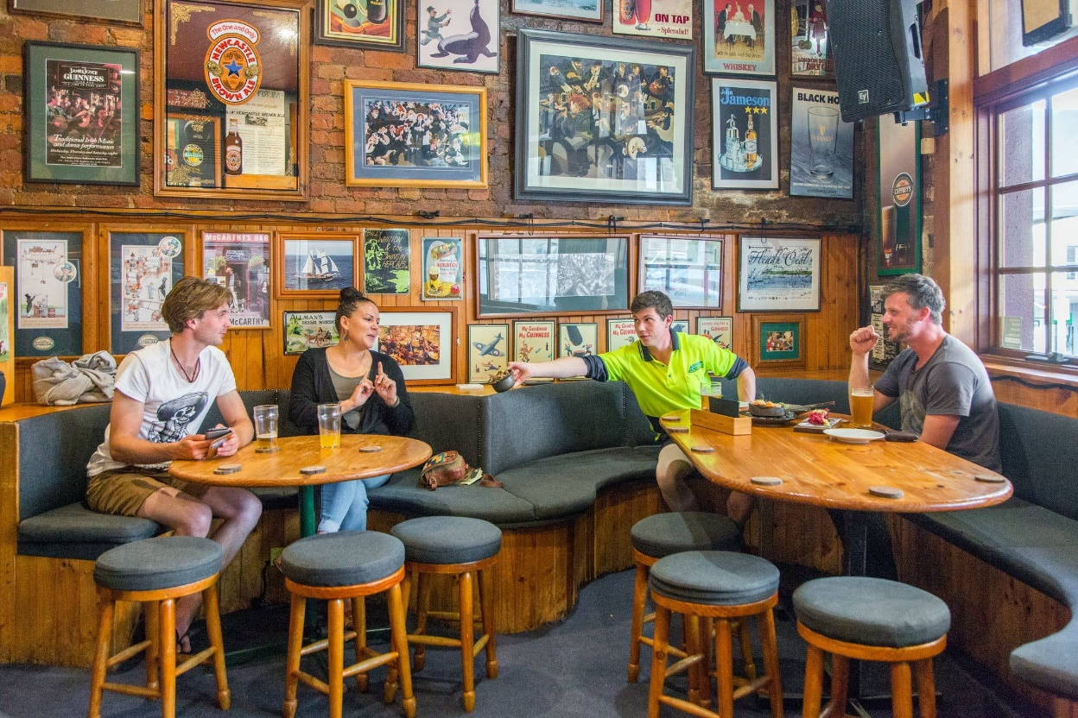
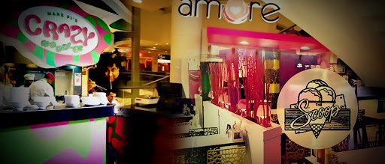
Over View -New Hospitality Set-up

Slide 5
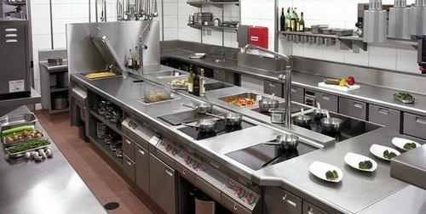
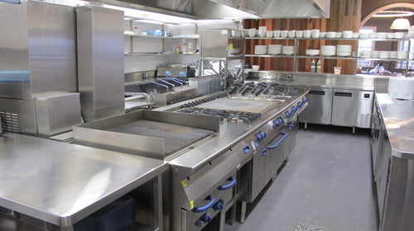
Commercial kitchen Equipment

Slide 6


Insurance policy

Slide 7


Travel & Tour Operator.

Slide 8


Manpower consultant.

Slide 9


International Patient Business

Slide 10


Welcome to The world of Help –self Development

